Slide 1
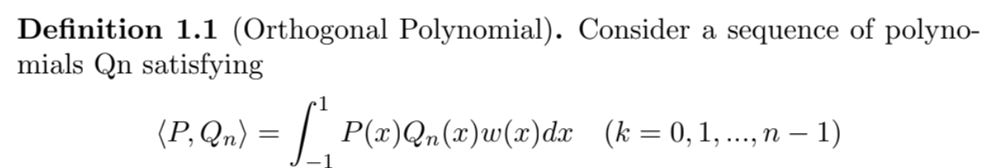
Orthogonal Polynomial
y
Sep 29. 2020
LoG(M)
(not related)
x

Slide 2
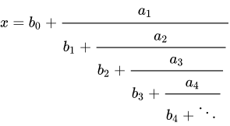

Applications
Continued Fraction
Gaussian Quadrature
$$\int{f\left(x\right)dx}= \sum_{i=1}^{n}{a_{i}f(x_{i})}$$
Statistical mechanics/ Random Matrix

Slide 3

Problem to solve
Find the zeros of the polynomial
Positive/negative w(x)
W= $e^{iwz}, e^{−inλz}$
Exhibit them
Analyze their behavior

Slide 4
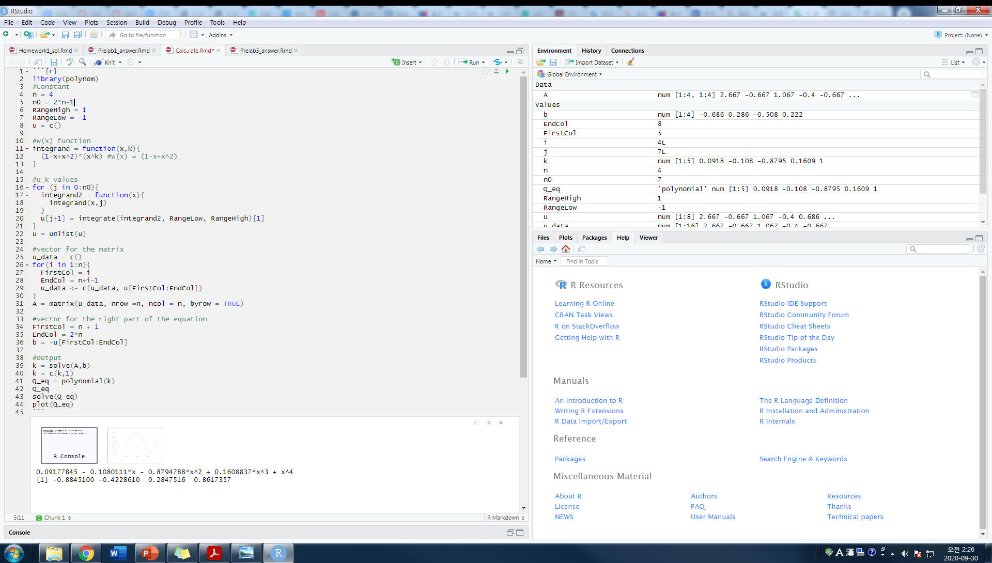


Programming

Slide 5
More theories
Hermitian Polynomials
Recursion relationship of Orthogonal Polynomials
Still learning
Thank you

